Slide 1
Pennsylvania Department of Health
Bureau of Communicable Diseases
Division of HIV Health
Special Pharmaceutical Benefits Program (SPBP)
John Haines, Pharm.D.

Slide 2
What is the Special Pharmaceutical Benefits Program?
State-administered AIDS Drug Assistance Program (ADAP) authorized under Ryan White Part B for low-income individuals living with HIV who have limited or no healthcare coverage
Provide U.S. Food and Drug Administration (FDA) approved medications to:
Treat HIV
Prevent the deterioration of health arising from HIV (including the prevention and treatment of opportunistic infections)
Also known as SPBP in PA
ADAPs available in each state, D.C., Puerto Rico, Guam, and U.S. Virgin Islands

Slide 3
ADAP legislative requirements
Ensure the medication from each of the core antiretroviral drug classes are provided
Provide assistance for the purchase of treatments determined to be eligible and any such ancillary devices necessary for administration
Provide outreach to individuals with HIV
Facilitate access to treatments for individuals
Document the process made in making therapeutics available to eligible individuals
Encourage, support, and enhance adherence to treatment regimens
Ensure ADAP is payer of last resort

Slide 4

Congress appropriations 2023-24
Ryan White Program across the US
  Part B base - $464,565,000
  ADAP earmark - $900,313,000
  Other parts (i.e. A, C, D, F, SPNS, EHE) - $1,206,163,000
  Total - $2,571,041,000

Slide 5
Pennsylvania Funding 2023-24
Program funding:
  Ryan White Part B base grant - $11,159,823
  Ryan White Part B ADAP earmark - $25,785,111
  Pharmaceutical rebates - $78,044,398
  Insurance recoveries - $5,258,557
  Total - $120,247,889

Slide 6
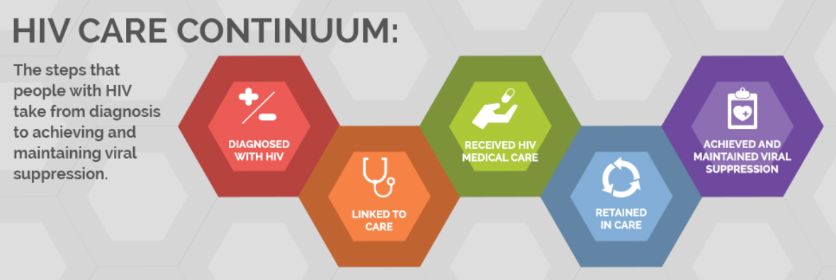
Continuum of care
Provision of medications, labs, and premiums
Medication Adherence
Enrollment and MAI
Re-enrollment and MAI

Slide 7
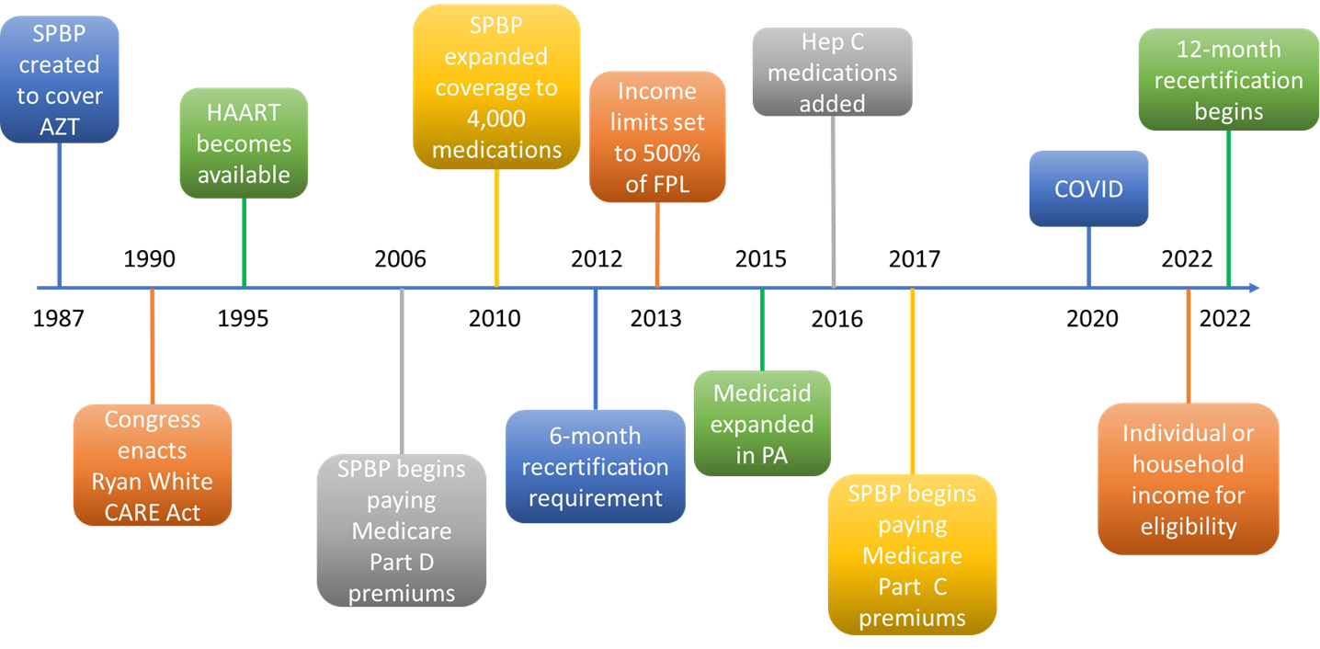
Timeline of SPBP

Slide 8
Program eligibility
Have a diagnosis of HIV
Live in Pennsylvania
Individual or household income less than or equal to 500% of the federal poverty level
Cannot be enrolled in Medicaid with full prescription benefits
Exception: Individuals dually enrolled in both Medicaid and Medicare with prescription coverage are eligible for SPBP

Slide 9
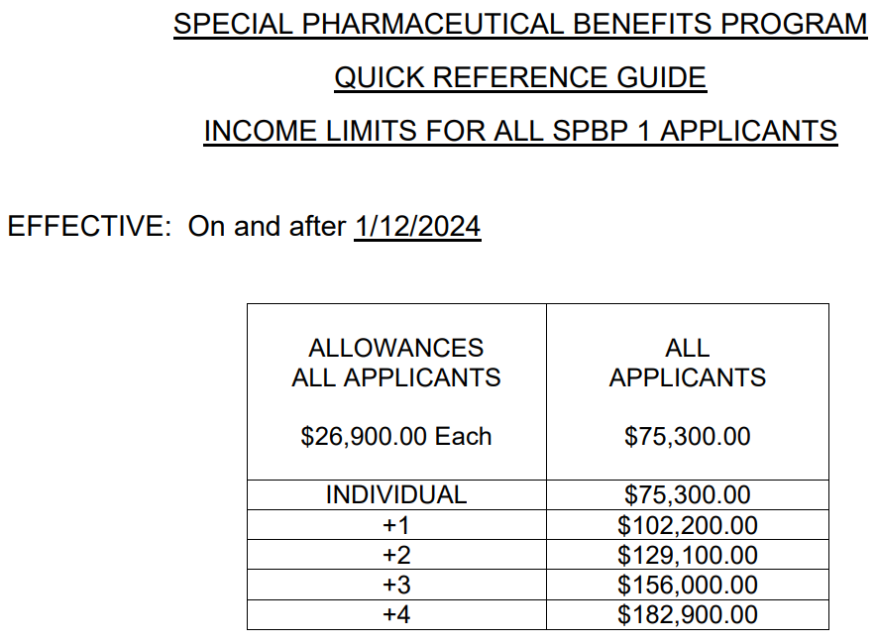

2024 income limits

Slide 10
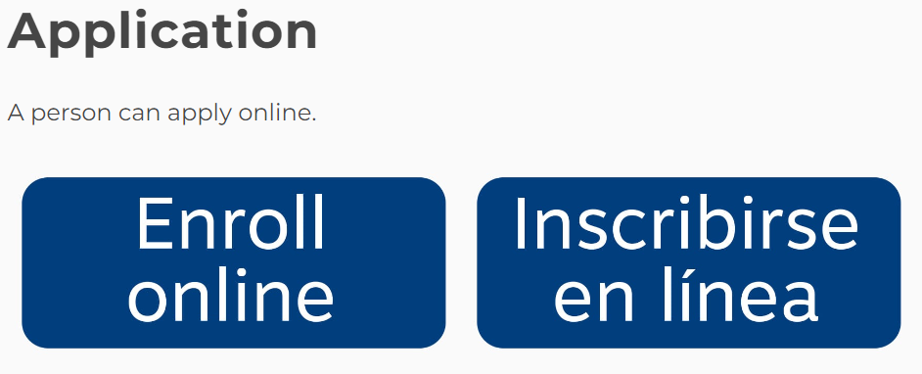

How to enroll
www.health.pa.gov/spbp
Fillable electronic applications and paper applications are available
Alternating full and express applications
12-month enrollment

Slide 11

Covered services
Medications
Lab testing
Medicare Part C and D premiums

Slide 12
Medication coverage
Approximately 4,000 medications are covered
Over 2,700 pharmacies are in-network
Covered drugs must be listed on the SPBP drug formulary and billed by an in-network pharmacy

Slide 13
Drug coverage for uninsured and insured individuals
For uninsured individuals
SPBP will pay the full cost of covered medications
For individuals with other insurance
SPBP will cover out of pocket costs (i.e. deductibles, copays) for clients secondary to the other insurance plan(s)
SPBP will pay the full cost for drugs not covered by the primary plan if they are listed on the SPBP drug formulary
All other prescription coverage must be billed prior to SPBP

Slide 14
List of covered drugs
HIV treatment medications (antiretrovirals)
Selected brand name, generic, and over-the-counter (OTC) non-antiretroviral drugs, biologics, and devices
Specific nutrients and nutritional agents
Drugs, biologics, and devices must be approved by the Food and Drug Administration (FDA)
All drugs (Rx and OTC) on the formulary require a written prescription from a licensed medical provider

Slide 15
Newer drugs/drug classes added
HIV treatment medications
  Combination injectable integrase inhibitor/non-nucleoside reverse transcriptase inhibitor – Cabenuva (cabotegravir/rilpivirine)
  Injectable HIV capsid inhibitor – Sunlenca (lenacapavir)
Contraceptives
Weight loss medications
Amyotrophic lateral sclerosis (ALS) treatment agents

Slide 16

Did you know these products are covered by SPBP?
Hepatitis C medications
Vaccines
Wearable diabetes treatment devices
Diabetic supplies
Narcan/naloxone
Smoking cessation agents

Slide 17
SPBP drug copays
The following copays apply to all active SPBP enrollees who receive covered medications at an in-network pharmacy.
  Brand drugs – $0
  Generic drugs – $0

Slide 18
Days’ supply maximum
Retail pharmacy – 34 days or 100 units, whichever is greater
Mail order pharmacy – 34 days or 100 units, whichever is greater
Specialty pharmacy - 34 days or 100 units, whichever is greater

Slide 19
Refill utilization minimum
Retail pharmacy – 75% of days supplied
Mail order pharmacy – 75% of days supplied
Specialty pharmacy – 75% of days supplied
Early refill overrides for lost or stolen medications and vacation supplies can be requested by calling the SPBP customer service team at 800-922-9384

Slide 20
Cost maximum per claim
1 to 34 days’ supply - maximum cost limit is $4,000 per claim
35 to 68 days’ supply - maximum cost limit is $8,000 per claim
69 days’ supply or greater - maximum cost limit is $12,000 per claim
Pharmacies should call the SPBP provider line at 800-835-4080 for overrides of claim costs submitted above these amounts.

Slide 21
Medication adherence
Goal of the program is to improve medication adherence of clients through pharmacist led consultations with providers and clients directly
Currently reviewing adherence to:
HIV antiretrovirals
Antihypertensives
Antidiabetic medications
Antidepressants

Slide 22
Current focus of adherence program
Outreach to newer providers, providers triggering with the most outliers, and outreach to multiple providers within the same office
Develop and maintain relationships with main points of contacts in offices for ease of future outreach
Work with provider offices to identify good candidates for medication management
Heightened focus on member outreach and practitioner follow up on high-risk cases

Slide 23
Current adherence consultations
Adherence Review Type | Unique Providers Identified | Unique Members Identified
HIV antiretrovirals | 411 | 2,177
Antihypertensives | 251 | 467
Antidepressant | 262 | 393
Antidiabetic | 191 | 315
 | 1,115 | 3,352
Current quarter consultations completed
Provider consultations | 56
Clients identified for medication management | 32

Slide 24
Medication adherence barriers
Most common barriers to adherence reported by providers and clients are:
  Lack of disease state education
  Patients lost to follow up
  Travel/relocation
  Forgetfulness
  Life event/stressors
  Untreated/uncontrolled depression and other disease states
  Hiding diagnosis status

Slide 25
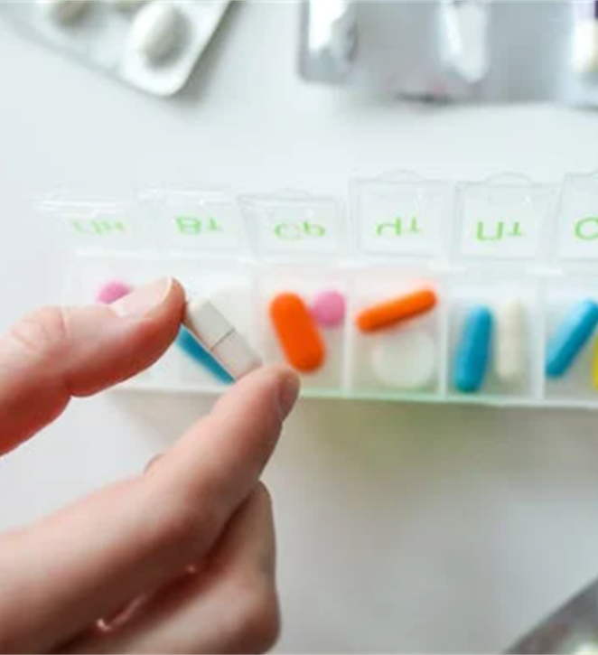
Solutions provided to improve adherence
Alternative medication regimens that may better suit client’s lifestyle (i.e. single drug regimen, long acting injectables)
Patient disease state education
Syncing multiple medication refills
Setting up auto-refills
90-day supplies
Mail delivery
Phone alarm reminders
Use of pill boxes

Slide 26
Laboratory services
For recipients who have no other insurance coverage
Individuals with other insurance are not eligible for coverage of labs by SPBP
Service must be accessed through any Medicaid enrolled lab or provider that can submit lab claims electronically to SPBP using the PROMISe system
Lab claims billed to SPBP through PROMISe are billed the same way that a laboratory bills Medicaid, except the SPBP ID is submitted for the client instead of a Medicaid ID

Slide 27
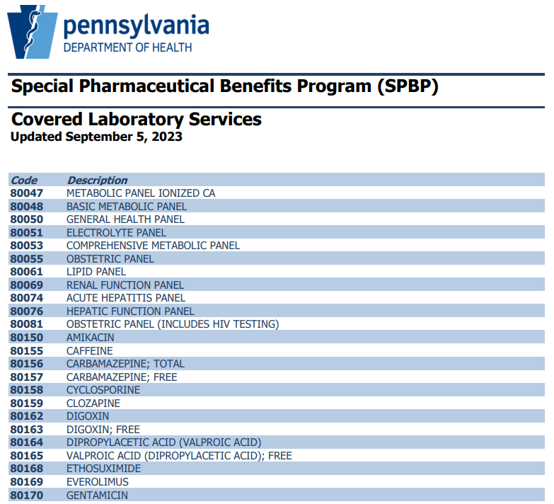

Covered lab tests

Slide 28
Medicare Part C and Part D premium assistance
SPBP pays the full monthly premium for Medicare Part C (advantage) and Part D (drug) plans that have an agreement in place with SPBP
SPBP will auto-enroll eligible clients into a Medicare Part D plan if the client is not already enrolled
The list of covered plans is available on the SPBP website at www.health.pa.gov/spbp
Silverscript Choice Part D plan
Wellcare Classic Part D plan

Slide 29
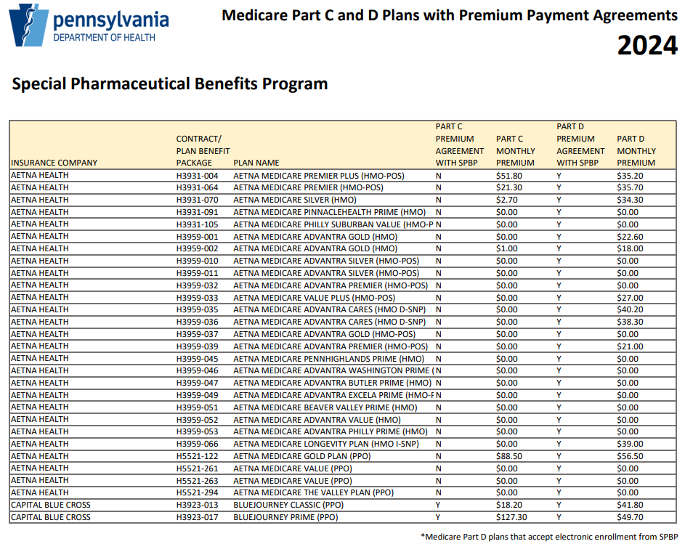

List of Medicare plans with agreements

Slide 30

SPBP data

Slide 31

2023-24 Ryan White fiscal year
Enrolled individuals – 8,369
Average age – 52
Age range – 6 to 92
Total medications paid - $94,457,635
Total medication claims – 194,479
Average cost per person – $11,287
Average cost per claim – $486

Slide 32
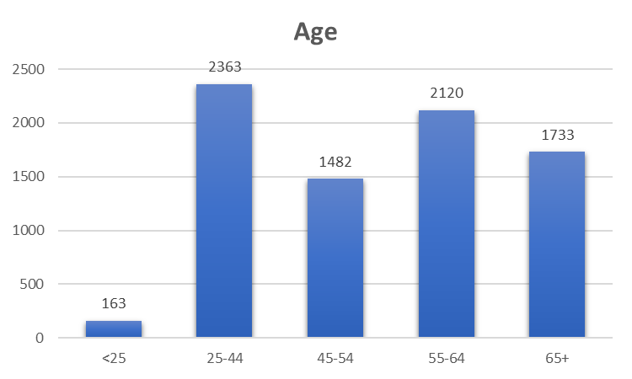
Age

Slide 33
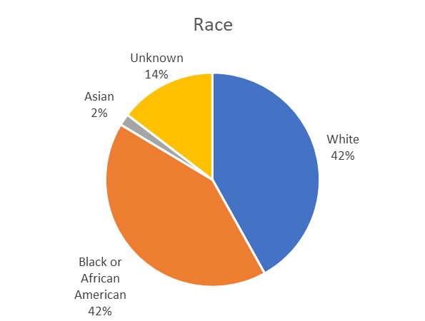
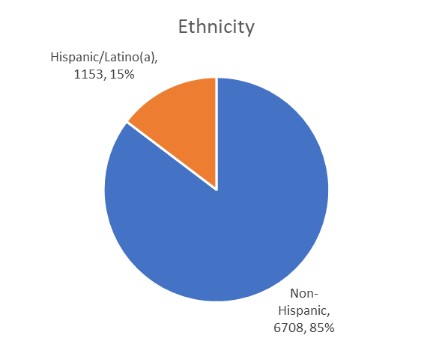
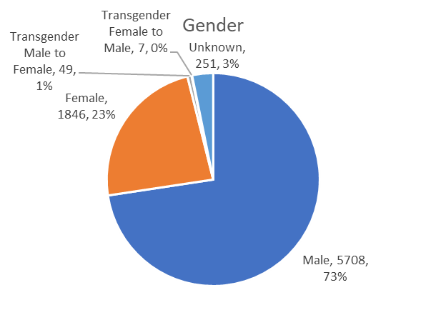
Demographics

Slide 34
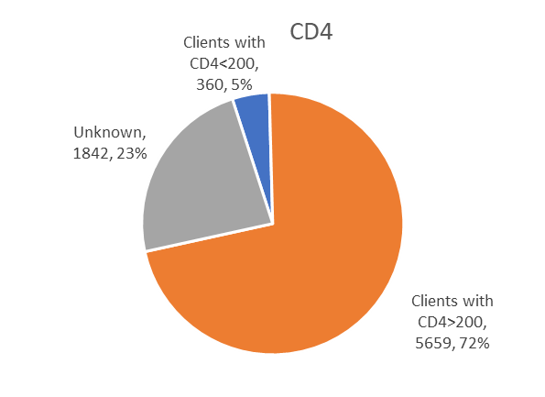
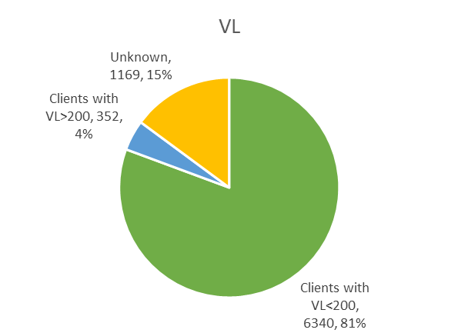
CD4 count and HIV viral load (VL)

Slide 35
Top 20 drugs by paid amount

Slide 36
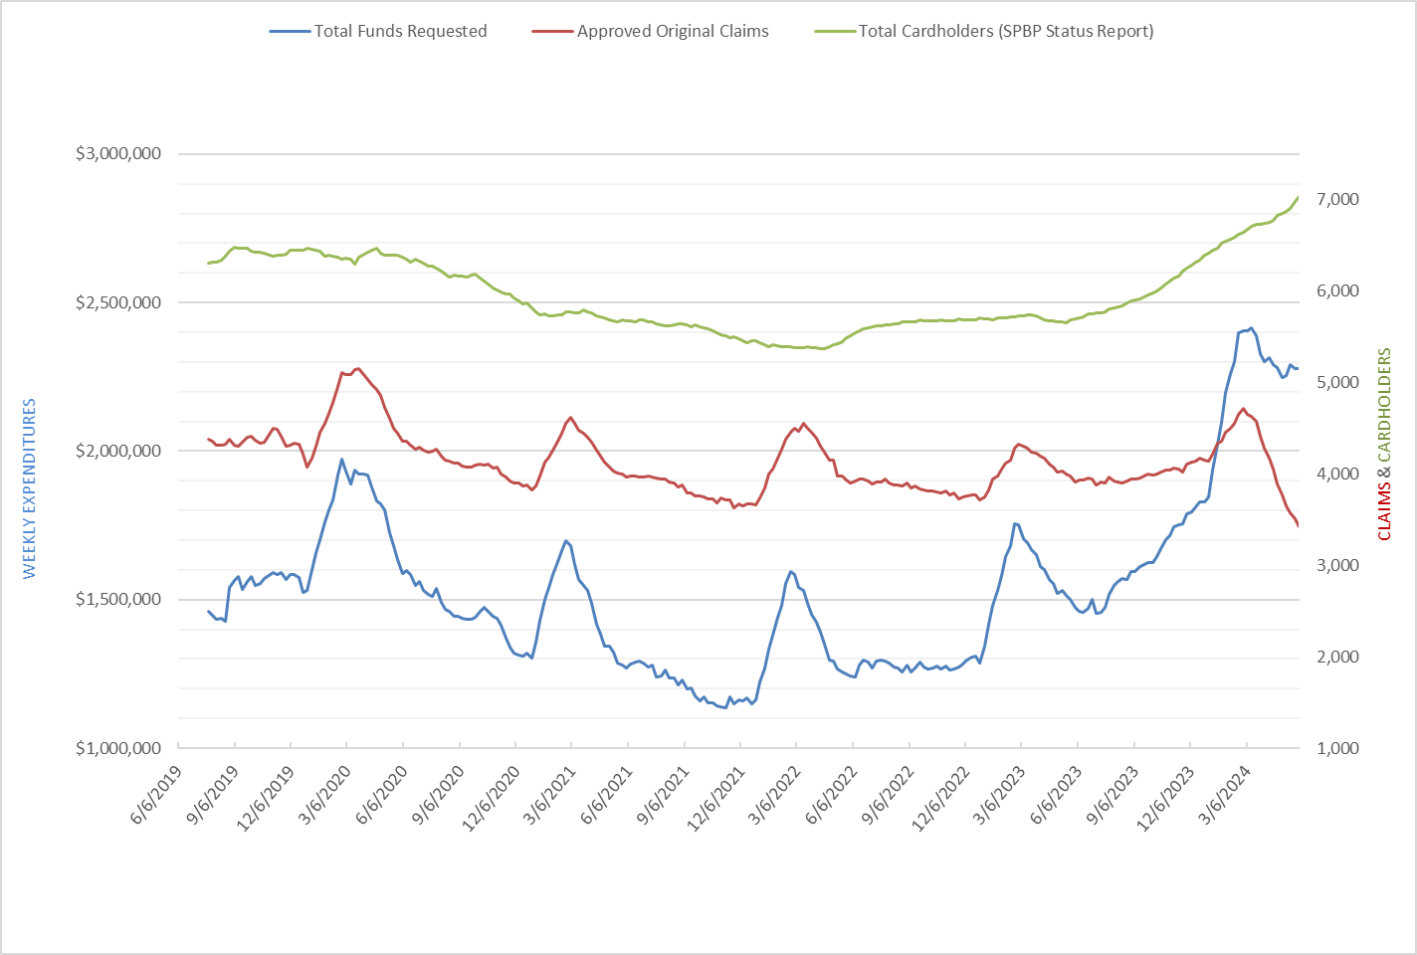
Five-year trends

Slide 37

SPBP customer service
Handles an average of 1,000 calls per month
Assists clients, case managers, and other callers regarding questions and issues related to SPBP
Provides information on:
  Enrollment status
  Pended application resolution
  Medicare Part C & D premiums
  Medicaid expansion
  Coordination of benefits
  Medication and lab billing issues

Slide 38
Types of Calls
Top 3 reasons for calls to customer service
  To check on status of enrollment
  To find out how to resolve pended applications
  To request extensions of SPBP enrollment for individuals waiting for Medicaid enrollment
    Individuals that appear eligible for Medicaid and not yet enrolled are required to apply to Medicaid
    3-months of SPBP coverage can be approved if eligible until individual is enrolled in Medicaid or found not to be eligible for Medicaid

Slide 39
Pended Applications
Top 3 reasons applications are pended
  Missing information on documents submitted
  Illegible documents submitted
  Documents never received

Slide 40
Pharmacy benefits manager
Prime Therapeutics/Magellan Rx Management serves as the pharmacy benefits manager (PBM) for SPBP
Processes enrollment applications
Verifies eligibility based on SPBP policies
Provides ID cards to clients
Manages a provider call line and Medicare premium assistance call line
Processes drug claims and handles claim rejections
Tracks and invoices for drug manufacturer rebates on behalf of the SPBP

Slide 41
SPBP Advisory Council
Provides input and recommendations to SPBP concerning the SPBP drug formulary and program activities
The Advisory Council is made up of approximately 20 members from across the state
Comprised of recipients, clinicians, case managers, pharmacists, and other stakeholders
Accepts applications for membership at any time during the year and fills positions on an as-needed basis
Meetings held quarterly
Two conference calls and two in-person meetings
All meetings are open to the public

Slide 42
SPBP website info
www.health.pa.gov/spbp
Eligibility info
Online enrollment and applications
Tutorial videos
Contact and appeals info
Covered services
HIPAA rights
Provider policy manual
Advisory Council info
Other resources

Slide 43
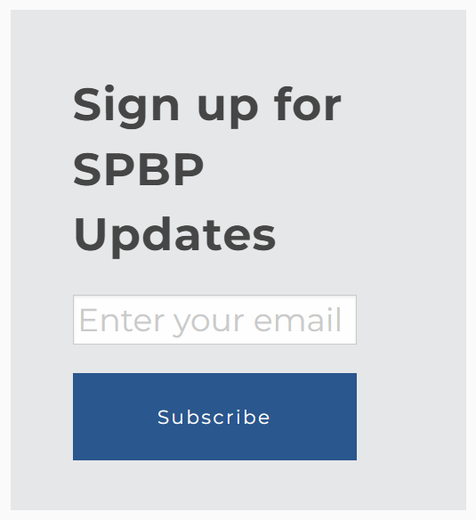
SPBP listserv
Sign up online at www.health.pa.gov/spbp

Slide 44



SPBP contact information
Customer service line:
1-800-922-9384
Email:
SPBP@pa.gov
Website:
www.health.pa.gov/spbp

