Slide 1
Ending the HIV Epidemic Pennsylvania
A Statewide initiative
HPG – July 10, 2024

Slide 2
OUTLINE
AIDS Free Pittsburgh
The Issue
The Proposal
The Logistics
Why JHF
Summary
Questions

Slide 3

PROVEN MODEL
MISSION: Achieve an AIDS Free county (no new AIDS cases) and reduce the rate of HIV infections 75% by 2030
VISION: We envision a community where new HIV infections are rare, people living with HIV receive the care they need, and young people can grow up in a world without AIDS.
Launched: December 1, 2015 (World AIDS Day)
aidsfreepittsburgh.org

Slide 4
AIDS FREE PITTSBURGH
Inspired by other ETE/EHE initiatives (NY, WA, SF)
Key financial support
  Joint funding pledge from Allegheny Health Network and UPMC
  City and County Council Endorsement
Collective impact model
Timeline
  2015: Initiative started
  2016: Hired first dedicated staff
  2024: 5 dedicated staff (provide backbone/organizational support)

Slide 5


















AIDS FREE PITTSBURGH PARTNERS
AIDS Free Pittsburgh is financially supported by the Allegheny Singer Research Institute (AHN), UPMC Presbyterian Shadyside, and is managed by the Jewish Healthcare Foundation.

Slide 6
AIDS FREE PITTSBURGH
Normalize HIV Testing – Increase the rate of routine screening for HIV in accordance with the Centers for Disease Control and Prevention and the United States Preventive Services Task Force guidelines.
Increase Access to PrEP - Increase awareness of Pre-Exposure Prophylaxis (PrEP) in the community and build capacity for healthcare providers to identify eligible patients and prescribe PrEP.
Improve Linkage to Care - Use established relationships within the medical community to ensure that people diagnosed with HIV are quickly linked to high-quality care, facilitating faster treatment for those who need it.

Slide 7
STRATEGIC PLAN
AFP strives for:
Increasing linkage to care
Reducing transmission
Increasing PrEP/PEP awareness and delivery
AFP works to:
Expand HIV prevention and support service awareness
Engage with the community to understand changing needs

Slide 8
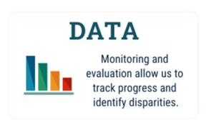
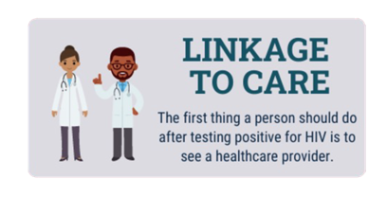
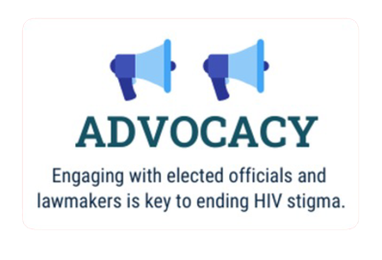
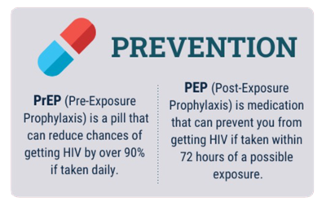
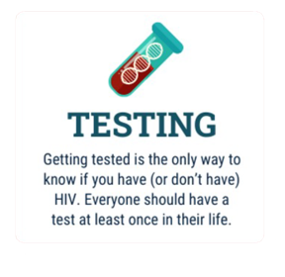

ACTIVITIES

Slide 9


OUTREACH
Media campaign/advertising
  Website, print materials, public transit ads, billboards, dating app ads
Social media
Tabling at community events
  Brochures, safer sex kits, at-home HIV tests
AFP-hosted events
  Too Hot for July
  Provider/community panels

Slide 10

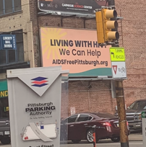




MEDIA CAMPAIGN
Built with community input on design and messaging
Surveyed the values of southwest Pennsylvanians

Slide 11

MEDIA CAMPAIGN
Digital Display
Direct Mail
Print
Terrestrial Radio
Streaming TV
Billboards
Transit Ads
Events
Social Media
Bus Shelters
Streaming Audio
Website Development
Search Engine Optimization
Mall Advertising
Strategic Event Sponsorship

Slide 12













Slide 13

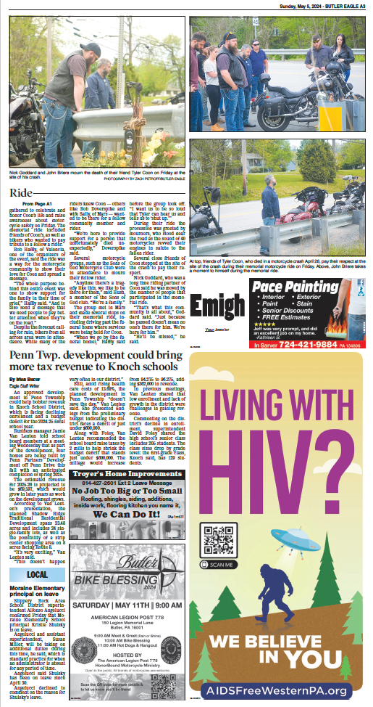


Slide 14
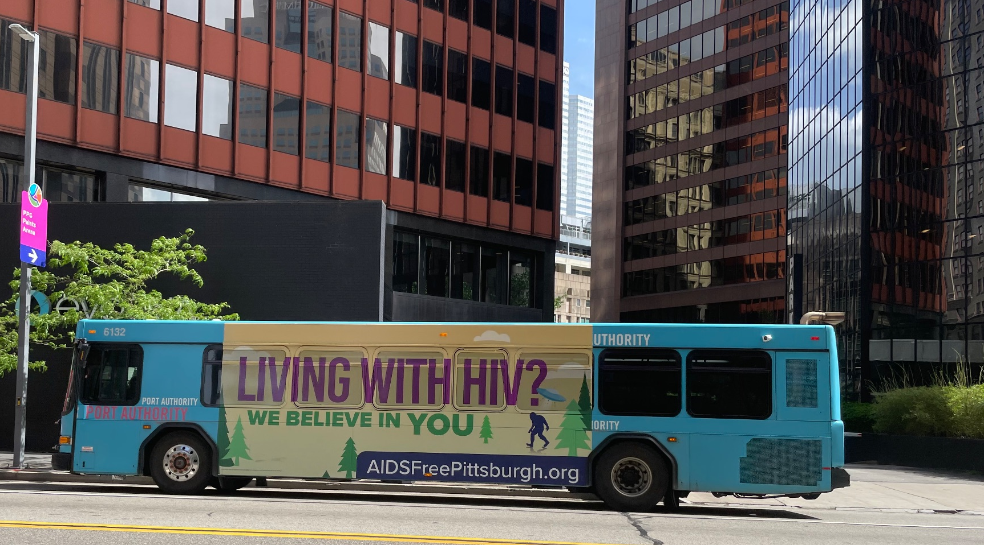

Slide 15
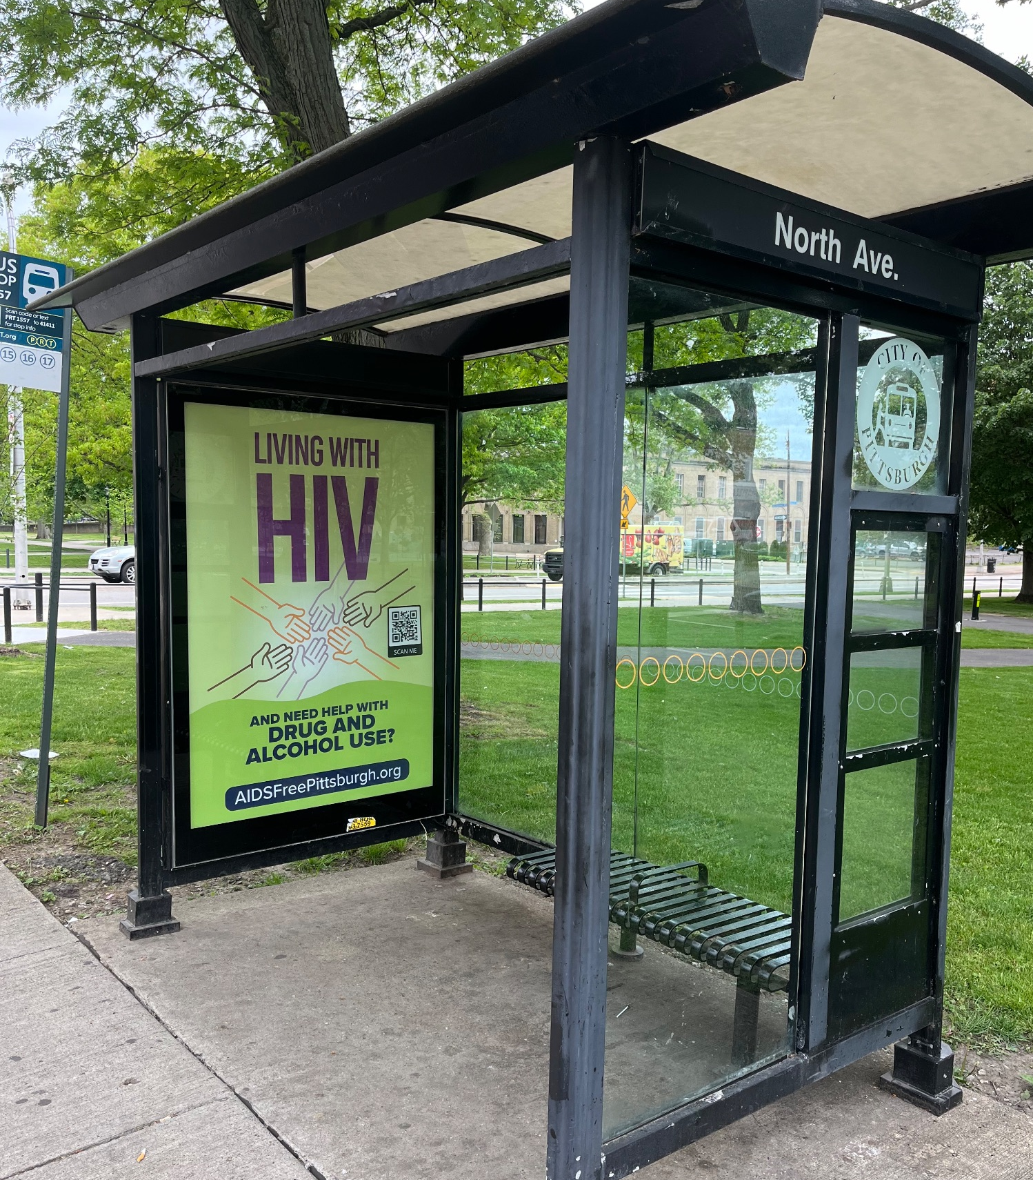
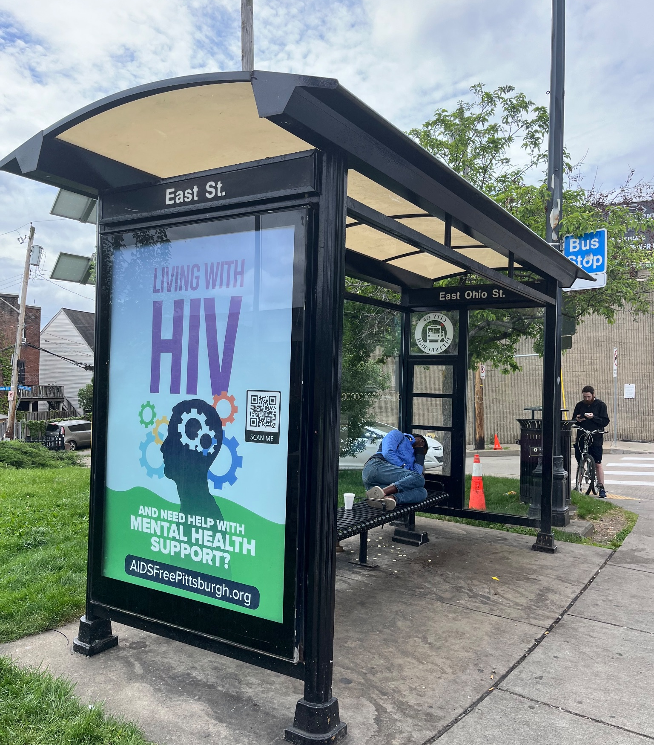
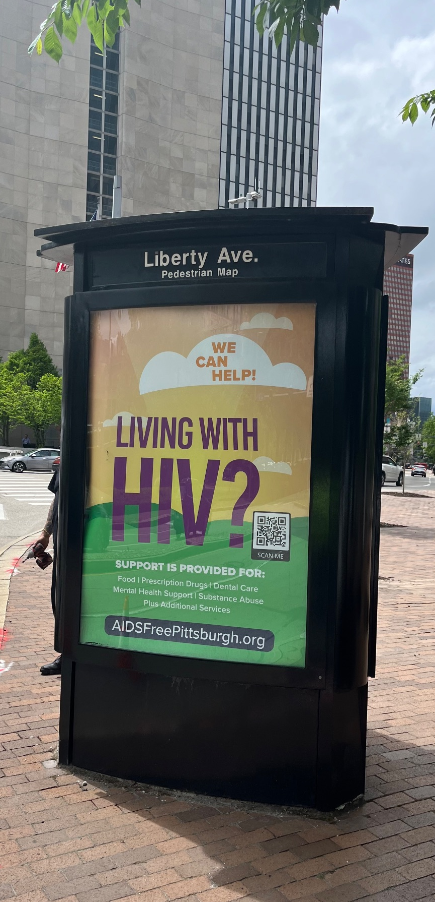

Slide 16
MEDIA CAMPAIGN
251,441,244
TOTAL ADVERTISING IMPRESSIONS

Slide 17
DIGITAL ADS
July 2023 through June 2024
57,211
31,903,424
.18%
Visits to website
Impressions
Click Through Rate
Strong CTR continues to drive traffic → 2x national average for digital display

Slide 18
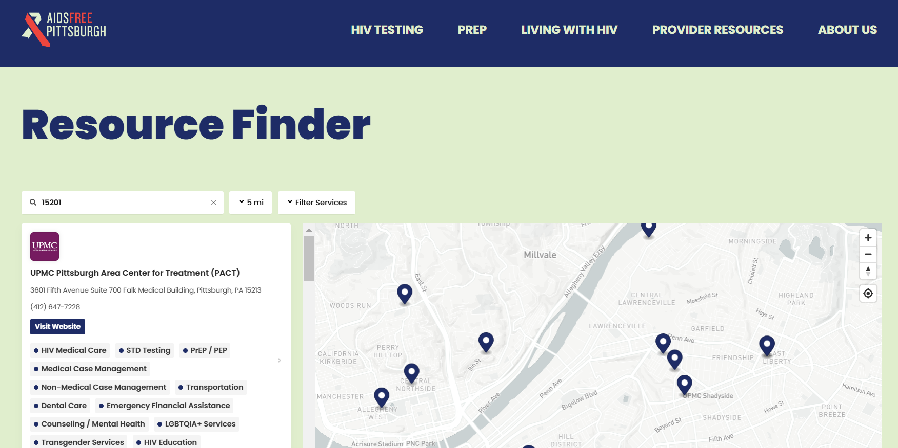

COMMUNITY RESOURCES
Developed with community input
Developed with vendors who identify in communities impacted
Website includes info on testing, PrEP, and services
Interactive online map to find resources (provider directory)
Print materials – brochures, coasters, etc.

Slide 19


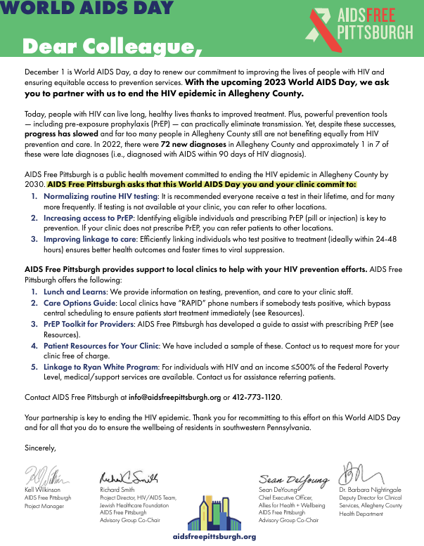
PROVIDER RESOURCES
HIV Care Options Guide: a guide to clinics, providers, and the healthcare coverage they accept
PrEP Toolkit: guide on how to prescribe PrEP
Dear Colleague letter campaign: letter sent to general providers, OB/GYNS, and plasma centers

Slide 20
RAPID LINKAGE TO CARE
HIV primary care clinics have protocols to expedite linkage to care for those newly diagnosed
Dedicated phone numbers for RAPID referrals
  Bypass central scheduling
  Included in Care Options Guide

Slide 21


EVENTS
Too Hot for July: HIV Awareness event celebrating advancements in prevention and treatment
  Free public block party
  6 annual events
  >1,500 people in 2024
  Free HIV and STI testing, information from collaborative members, and performances
World AIDS Day events
  Over 130 people in 2023

Slide 22

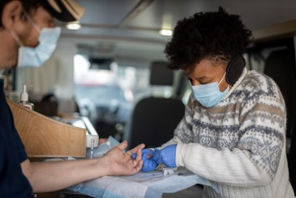
SPECIAL PROJECTS
HIV Testing Grants
  $125,000 two-year grant from Highmark Foundation
  Aim: normalize HIV testing through community outreach campaigns & mini grants
  Focus on priority populations more likely to be diagnosed late
Part of Fast-Track Network

Slide 23
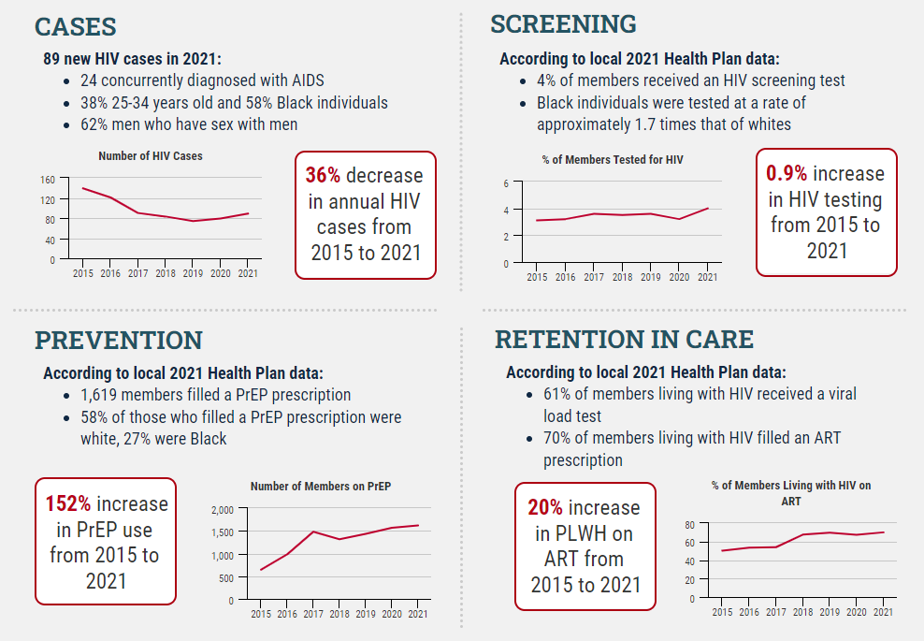
EVALUATION
Partner with county/state health dept. to track new diagnoses
Partner with local health plans to track PrEP uptake, ART prescriptions, viral load testing
Partner with local clinics for RAPID data and other metrics
Community surveys (e.g., PrEP Awareness Survey)
Goal: compile data for partners

Slide 24
THE ISSUE

Slide 25
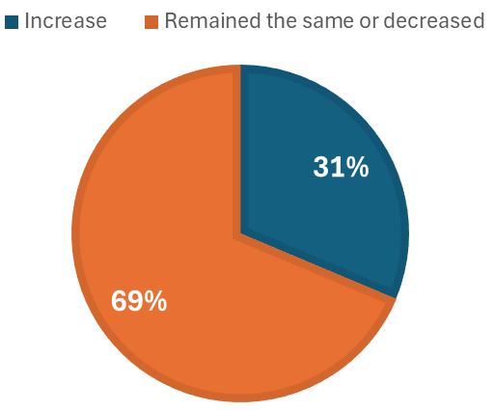
CURRENT STATE OF THE EPIDEMIC
PA Counties with Increase in New HIV Diagnoses from 2019 to 2022
Progress has been made in PA towards ending the HIV epidemic
Yet, rate of decline in new diagnoses has slowed and disparities persist

Slide 26
CURRENT STATE OF THE EPIDEMIC
Little change in rate of late diagnoses from 2019-2022
  23% in 2019
  24% in 2020
  23% in 2021
  22% in 2022
Health equity issues preventing access to PrEP
  ~33% of people using PrEP were people of color in 2020

Slide 27
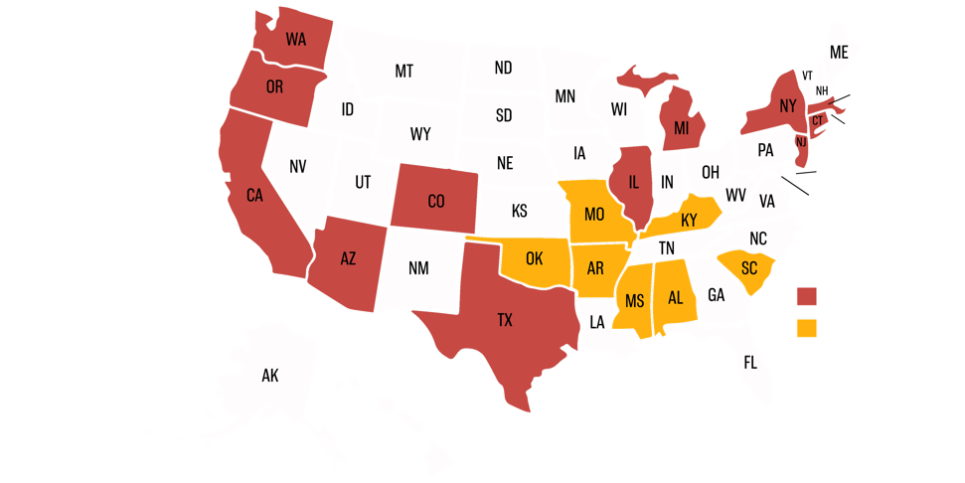
NO STATEWIDE EHE in PA
19 other statewide initiatives are already in place
12 self-initiated
7 DHHS EHE Focused
Notes:
Need to fix map

Slide 28



CONTINUED PROGRESS REQUIRES

Slide 29
THE PROPOSAL

Slide 30

Ending the HIV Epidemic PA – The Time is Now
Five-year plan to end HIV epidemic in PA
4 pillar approach
Coordinate info and resources
Foster community-level collaboration

Slide 31
PILLAR 1 – DIAGNOSE
Coordinate with PADOH and health systems to implement routine testing
Develop opportunities for sharing best practices (e.g., status neutral approach)
Establish statewide physician standing orders for testing (where applicable)
Facilitate provider trainings for how to identify who to test:
  Primary care, Emergency care, Urgent care
Support community health worker model

Slide 32
PILLAR 2 – TREAT
Establish statewide, online resource center for providers and community
Enhance RAPID linkage to care
  Dedicated phones to bypass central scheduling
Facilitate learning sessions
  Network opportunities
  Share best practices
  Gain outreach strategy skills, service delivery, trauma-informed care, etc.
  Draft action plans to better serve those affected by HIV in more cohesive and collaborative ways

Slide 33
PILLAR 3 – PREVENT
Educate providers on PrEP & PEP
  Continuing education opportunities
  Promote increased care coordination, especially in rural areas
Expand telehealth PrEP/PEP options
Combat barriers to PrEP/PEP access
  Lack of health insurance or coverage
  Investigate PrEP assistance program options
Conduct outreach to priority populations
  Develop unified de-stigmatizing advertising and marketing materials for PA
  Map and directory of PrEP providers on website

Slide 34
PILLAR 4 – RESPOND
Respond pillar to be finalized in partnership with PADOH
Consider diverse needs of those impacted by HIV
Reduce stigma by removing stigmatizing language, policies, or imagery
Collaborate with PADOH on responses to HIV outbreaks
Ensure synergy with other epidemics (COVID-19, STIs)

Slide 35
THE LOGISTICS

Slide 36
COLLECTIVE IMPACT MODEL
Proven model for public health change
No single policy, government entity, or organization can tackle this issue
This model brings together a network of key organizations, institutions, and community members in a structured way to work together towards a common goal
Removes silos and isolated efforts
Moves beyond simple partnerships and collaborations

Slide 37
COLLECTIVE IMPACT MODEL
Common Agenda
  Partners agree to the mission, vision, goals & strategies
Common Progress Measures
  Partners agree to standard data indicators
Mutually Reinforcing Activities
  Partners leverage their organizational resources to support the initiative's mission and goals
Communications
  Partners participate in regular initiative-wide and subcommittee meetings
Backbone Organization
  Dedicated full-time and part-time staff to support the initiative (fiscal agent: JHF)
Source: Kania, J. & Kramer, M. (2011). Collective Impact. Stanford Social Innovation Review. Winter: 36-41.

Slide 38






COLLECTIVE IMPACT WORKS

Slide 39
THE STRUCTURE
At the PADOH suggestion, we hope for this initiative to be a new subcommittee of HPG
Subcommittee will meet virtually outside of normal HPG meetings to not interfere with current subcommittee activities
Partners for the initiative will expand outside of those with HPG
HPG
Ending the Epidemic PA
Notes:
To not duplicate statewide groups

Slide 40

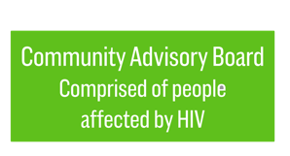


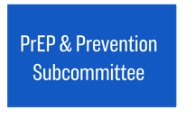

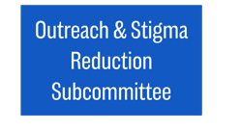
THE STRUCTURE
Advisory Group
Comprised of HPG subcommittee*
To include regional managers, key partners, PADOH, and JHF staff
*Will collaborate with HPG and PADOH to determine the most effective implementation of community advisory board. However, there are benefits of a virtual group that can go beyond the barriers of HPG (e.g., travel requirements, having to take time off work)
Jewish Healthcare Foundation staff
will provide backbone and organizational support
Executive Team
1 JHF staff, 1 PADOH staff, regional managers, HPG subcommittee chair, and 2-3 other key leaders/subject matter experts

Slide 41



PLANNED PARTNERS
Will leverage partnerships PADOH already has in addition to developing new ones.
Regional Ryan White projects
AIDS Service Organizations
Universities
PA Department of Education
Statewide HIV Planning Group (HPG)
HIV-related agencies (clinics, social services organizations)
Non-HIV related agencies (agencies that provide services related to social determinants of health)
Faith-based organizations
State prison system
Legislators
Local health departments
Health systems
Health insurance providers
Harm reduction agencies (housing, etc.)
Hepatitis C and overdose prevention initiatives
Local foundations and non-profits
Community-based organizations
Title X providers
Notes:
INTENTION: Coordinate with and enhance current activities of these agencies, not replace. State how these are the intended partners, many (but not all) of whom have provided letters of support for this initiative.

Slide 42
FOCUS OF ACTIVIES
GOALS
Normalize routine testing
Decrease stigma
Increase access/uptake of PrEP and other prevention tools
Efficient linkage to care and treatment
ACTIVITIES
Coordinating statewide media campaigns and digital marketing
Improving communication of resources to the community (website development, interactive maps)
Patient resources
Provider resources

Slide 43
GOALS AND OUTCOMES
SMART Goals by 2030 | Outcomes
 | Increase in: | Decrease in:
95% of PWH know their HIV status | People who know their status and are linked to care | Transmission among undiagnosed
95% who know status on ART | Number of people virally suppressed | Community transmission
95% who know status with routine viral load
95% who know status on ART with suppressed viral loads

Slide 44
GOALS AND OUTCOMES
SMART Goals by 2030 | Outcomes
Eliminate HIV-related deaths | Increase in the health of those with HIV
50% increase in PrEP uptake among priority populations | Decrease in community transmission
Expand RAPID linkage to care protocols to all major health systems in the state | Increase: Linkage to care | Decrease: Community transmission

Slide 45
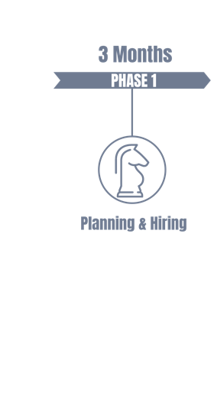
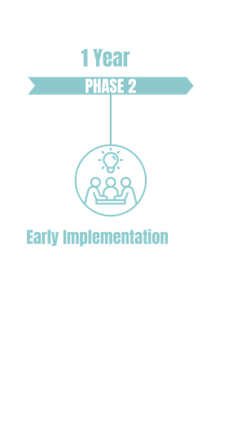
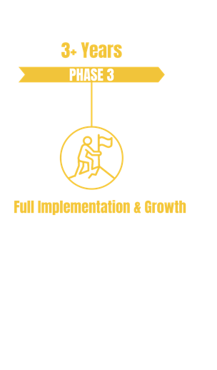
IMPLEMENTATION
  Advertise job descriptions and hire
  Develop bylaws, charter, etc.
  MOU with HPG
  Philly partnership
  Finalize advisory group and executive committees
  Letters of commitment
  Continue partnership development
  Establish final organization structure and committees
  Establish statewide digital meeting house; website development with map and toolkits
  Hold first statewide meeting
  Subcommittees
  Establish data agreements; solidifying data metrics, analysis processes, and reporting
  Develop unifying media messaging statewide
  Implement the four pillars

Slide 46

MEASURING SUCCESS
Proposed data sources to evaluate progress:
Digital Marketing Data
Ryan White/Other Clinics
Insurance Health Plans
PADOH Surveillance Data/ Ryan White Data
Number of clicks/views on online advertisements and the initiative’s website
Establish data use agreements with clinics to collect linkage/retention in care and viral suppression data
Establish data use agreements with health insurance plans to collect PrEP uptake, viral load testing, and ART uptake data
Case counts, late diagnoses, demographics, viral load data, etc.
JHF will collaborate with PADOH to determine most effective data collection, management, and storage.

Slide 47


COORDINATION WITH HPG
Will collaborate with HIV Prevention & Care Project (University of Pittsburgh) and HIV Planning Group
Propose being a standing agenda item in HPG meetings
Will ensure efforts do not duplicate or override the work of the HPG

Slide 48
WHY JHF?

Slide 49


FISCALLY RESPONSIBLE & COMMUNITY COMMITTMENT
Will work within regulations regarding PADOH funding
JHF has 30+ years of fiscal responsibility related to state/federal HIV funds
JHF has history of successfully securing funding from major partners for other initiatives (e.g., AHN, UPMC)

Slide 50
SUMMARY

Slide 51

SUPPORT
To date we have received >35 letters of support from:
  County health departments
  Part B regional grantees
  Part B subgrantees
  Part C grantees
  MAI subgrantees
  Support service agencies across PA
  Fast-Track Cities/IAPAC
  Highmark Wholecare

Slide 52
NO STATEWIDE EHE IN PA
Current need for this type of initiative in PA
JHF has the expertise for implementation
Proven successful track record with AFP
Let’s put Pennsylvania on the map and cement our legacy for ending HIV

Slide 53
QUESTIONS?

